Slide 1
DH02 Data de-identification made simple
Jørgen Mangor Iversen, LEO Pharma, 2016

Slide 2
Introduction
Inspiration
PhUSE: De-Identification Standard for CDISC SDTM 3.2
PhUSE de-identification working group
20-May-2015
PHUSE_STDM_redaction.xls
Available for members on the PhUSE web site
Small set of well defined rules
Exhaustive list of rules per variable

Slide 3
Introduction
Basic idea
Metadata extract from definition spread sheet
Metadata extract from trial data
Match trial and definition metadata
Determine order of operations
One operation => one macro
Execute and report

Slide 4
De-Identification Standard
Rules
Recode subject ID (key across domains)
Recode ID variable (independent)
Offset (dates as if all begins on the same date)
Remove (variables)
Keep (no action)
No further de-identification (no action)
Elevate to continent (simple mapping)
Derive Age (handle few very old subjects)
Aggregate Age (manual assessment)
Review and only redact values with personal information (manual)
Remove dataset (always CO, maybe SU and others)
Remove observation (not in standard)

Slide 5
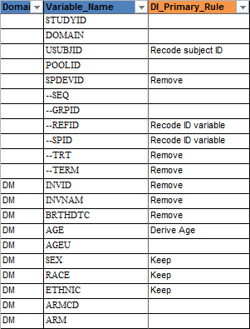
De-Identification Standard
SDTM Implementation Guide definitions
Small excerpt of interesting columns

Slide 6
Metadata
Mapping rules to macros
proc format;
value $rules
'Remove dataset' = '%di_remove_dsn'
'Derive Age' = '%di_derive_age'
'Offset' = '%di_offset'
'Elevate to continent' = '%di_continent'
'Recode subject ID' = '%di_recode_subject'
'Recode ID variable' = '%di_recode_id'
'Remove' = '%di_remove_var'
'Keep' = '%di_keep'
'No further de-identification' = '%di_no_further'
'Review and only redact values with personal information' = '%di_manual'
other = '';

Slide 7
Metadata
Prioritize operations
proc format;
invalue rules
'%di_remove_dsn' = 1
'%di_derive_age' = 2
'%di_offset' = 3
'%di_continent' = 4
'%di_recode_subject' = 5
'%di_recode_id' = 6
'%di_remove_var' = 7
'%di_keep' = 9
'%di_no_further' = 8
'%di_manual' = 10
other = 99;

Slide 8
Metadata
Mapping countries to continents
Obtaining metadata apparently difficult
SAS maps data always at hand
maps.names, maps.metamaps
Merge by name and isoname
Slightly different results. Use both and merge
Russia and Mexico(?) also in Europe!
Data needs to be fixed; duplicates removed
Once per new SAS version/maps update

Slide 9
Metadata
Study metadata
Strictly SDTM domains and variables
Global variables across domains
Without -- prefix; USUBJID, VISITNUM
Domain specific variables
Without -- prefix; AETERM, EXROUTE
List of domains from study datasets
Excluding SUPP-- domains
Other variables
With -- prefix, replaced with domain code
All variables
Merge and remove duplicates

Slide 10
Metadata
Study metadata principles
Merge enriched specification variable list with variables in study data
Add rules to each variable
Leave out all variables not in specification
Assign priority to each variable and sort

Slide 11
Operations
Preparing operations
Calculate offset per subject
Earliest of
RFSTDTC (first reference)
SVSTDTC (visit 1)
DSSTDTC (date of informed consent)
…as study start date
Each subject have individual offset relative to study start date
Create USUBJID look-up table
USUBJID must be consistent across domains

Slide 12
Operations macros
Common structure
Validate arguments
Derive any support values
Register operation
Categorize operation by importance
Perform operation
Update study data
Debugging comments
Stand alone test data

Slide 13
Operations
1. Remove dataset
Avoid superfluous work
Update metadata, remove as well!

Slide 14
Operations
2. Derive age
Age is expected in DM
May be empty; calculate
May need redaction
If any subject > 89 years old
Age unit may vary
Days, hours, weeks, months, years
Create plots of age distribution

Slide 15
Operations
3. Offset dates
Simple subtraction of offset from date
Handling of partial dates
Impute date to mid month/year as needed
Subtract offset from imputed date
Remove imputed date parts

Slide 16
Operations
4. Elevate to continent
Convert continent dataset to format
Create variable REGIONDI containing continent
Ensure REGIONDI has sufficient length

Slide 17
Operations
5. Recode subject identifier
All identifiers are recoded using the same algorithm
Recoding USUBJID requires re-sorting of the dataset

Slide 18
Operations
6. Recoding
Calculate max recoded value
Obfuscate variable (by un-sorting)
Sort by some semi-random sequence
Calculate new monotonic value from next multiple of 10 of max recoded value
215, 101, 147… becomes 1001, 1002, 1003…
Update values in situ

Slide 19
Operations
7. Remove variable
Delay dropping variables until after dependent values are calculated
Age depends on date of birth

Slide 20
Operations
8 & 9. Do nothing
Keep variable
No further action

Slide 21
Operations
10. Manual handling
Review and only redact values with personal information

Slide 22
Operations
Addendum to specification
Remove observation
Qval in SUPP-- may contain names and dates etc.
Subject initials
Investigators names and/or initials
Country should be removed after elevation to continent

Slide 23
Reporting
Messages collected
HTML output
Resorting messages
Operation 10, manual processing, is highlighted at the top of the list
Age distribution is plotted

Slide 24
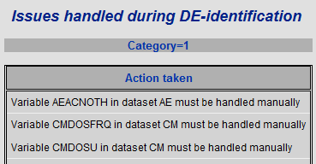
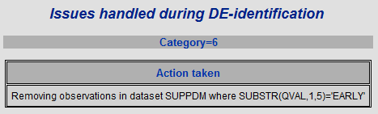
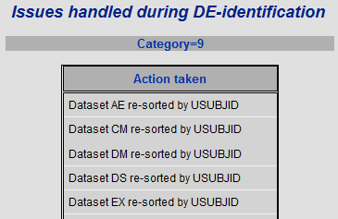
Reporting
Example of messages

Slide 25
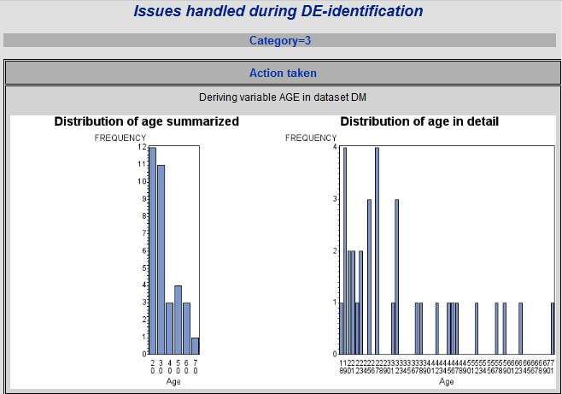
Reporting
Example of age distribution

Slide 26
Process
Always several iterations
Setup and run the program suite
Inspect the report for manual operations and age distribution
Inspect all domains for dates, names, initials etc. not mentioned
Insert study specific operations
Run again
Repeat

Slide 27
Summary
Solution statistics
16 programs and macros including metadata build
1062 Lines of code
15% comments
< 900 lines of code doing something
10 Days of work
5 Days of testing (15 remaining)

Slide 28
Summary
Reference and contact
Download metadata from http://www.phuse.eu/Data_Transparency_download.aspx after filling the form.
Contact details
Jørgen Mangor Iversen
LEO Pharma A/S
jmidk@leo-pharma.com

Slide 29
Questions
?
…and hopefully answers

